Slide 1

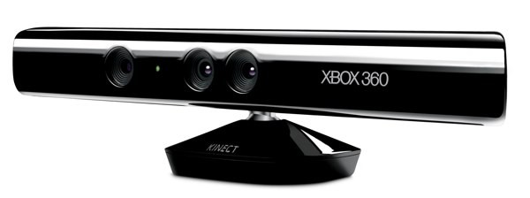

Slide 2
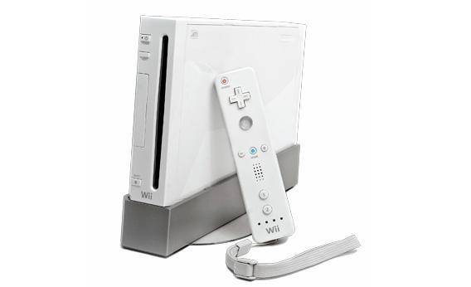
Kinect v0.1
Wait, what? More than just technology catch-up.
Johnny Lee (Carnegie Mellon) *
Motion-Tracking/Head-Tracking/Virtual Whiteboard
http://www.ted.com/talks/johnny_lee_demos_wii_remote_hacks.html

Slide 3

Kinect v0.5
Introduced at E3 2009 (Launched ~E3 2010)
Thought to be MSFT’s response to Wii
Separate unit that doesn’t require 360 upgrade*
Uses 1 core of multi-core Xenon processor inside 360 - 10-15% of overall 360 resources

Slide 4
Kinect v1.0+
Cool technology, why limit to 360?
Adafruit contest for open-source drivers *
- Goal: RGB, Depth
- See also: OpenKinect/libfreenect
MSFT’s response – mixed signals **
Official SDK released Jan 2011 ***
- C#, C++, and Visual Basic supported
- Depth, RGB, Skeletal, Microphones

Slide 5
Kinect Today
SDK & Open Source lead to lots of new devs, projects (http://www.kinecthacks.net/) *
- “Official” devs making Windows apps, games
V1.5 SDK – Has GUI debugger for user interaction, seated/near person-positioning
Johnny Lee – Google employee **
18 million units sold by Jan 2012

Slide 6
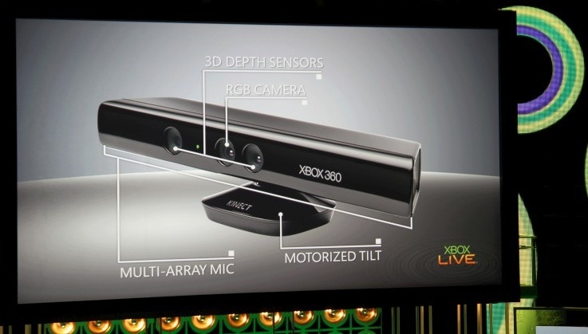
Hardware

Slide 7
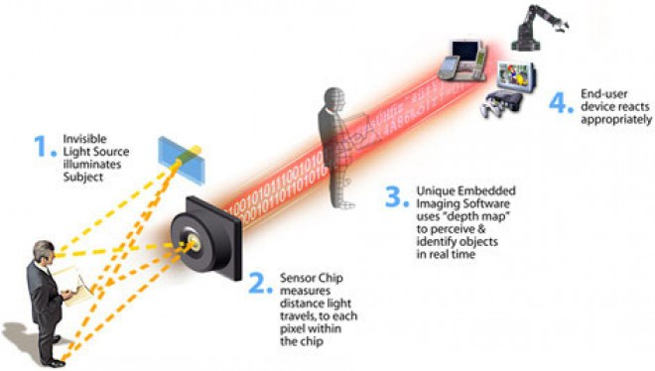
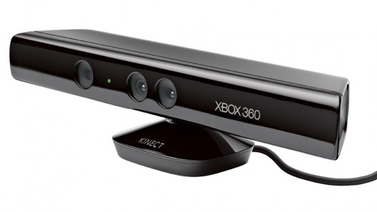
3D Depth Sensors
IR Projector
CMOS Sensor
Consists of IR projector and a CMOS sensor
IR beam bounces off subject and is captured by the CMOS sensor.
Sensor uses time to measure distance of objects

Slide 8
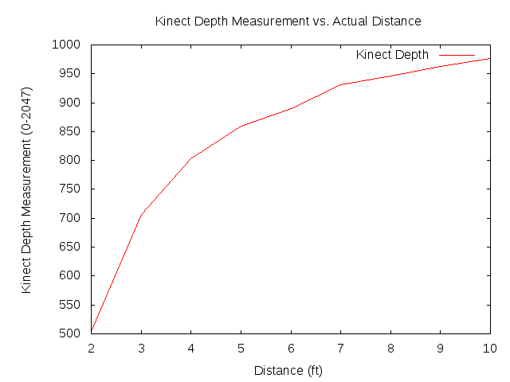
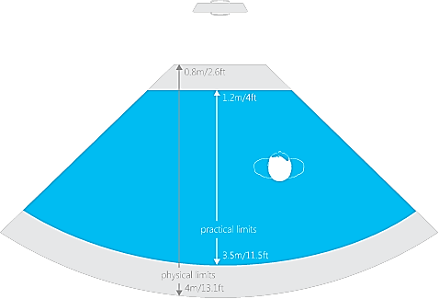
Distance Accuracy

Slide 9
RGB Camera
Used for Facial Recognition and other features that require RGB readings.
640 x 480px at 30fps
11-bit depth, meaning 2048 colors
RGB Camera

Slide 10
Camera Comparison
http://www.aptina.com/products/image_sensors/index.jsp?incoming=1&form3=3&navId=H0,C1,C3&categoryId=3&action=RESET

Slide 11
Microphones
4 Microphones on the device
Supports single speaker voice recognition
16-bit audio sampled at 16kHz
Microphone Array

Slide 12
Processing
Natal housed a microprocessor to compute skeletal structure
All processing now has moved to the central Xbox 360 CPU

Slide 13
Kinect SDK
Camera Basics
Depth Basics
Skeletal Basics

Slide 14
Camera Basics
Polling vs. Eventing
polling async, eventing sync
allFramesReady event
Camera Generates byte array of pixels
Camera tilt
range -27 to 27 degrees
returns tilt based on mount angle

Slide 15
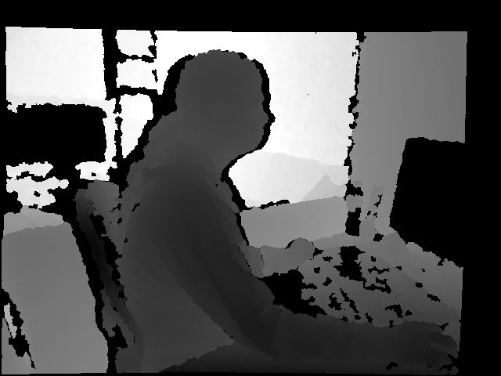
Depth Basics
Depth data for every pixel
distance (mm)
player (1-6)
Default & Near modes
near only provides a hip joint

Slide 16
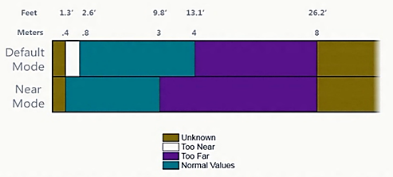
Distancing

Slide 17
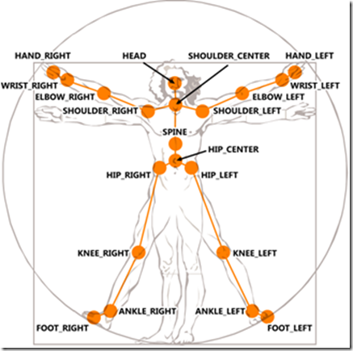
Skeletal Tracking
Tracks 1-2 players
xyz coordinates (z = dist. from camera)
State
tracked, not tracked, inferred
Smoothing
Scaling

Slide 18

Disney REVEL
Kinect + Reverse Electrovibration = Awesome
http://www.youtube.com/watch?v=L7DGq8SddEQ

Slide 19
Bibliography
Johnny Lee’s Wii Projects:
http://johnnylee.net/projects/wii/
The Future 360: Project Natal takes shot at Wii
http://news.cnet.com/8301-17938_105-10253586-1.html
Open-Kinect (Open-Source Kinect Driver)
http://openkinect.org/wiki/Main_Page
Kinect for Windows (Official SDK):
http://www.microsoft.com/en-us/kinectforwindows/

Slide 20
Bibliography
How Microsoft Kinect Works:
http://electronics.howstuffworks.com/microsoft-kinect2.htm
How Motion Detection Works in Xbox Kinect:
http://www.wired.com/gadgetlab/2010/11/tonights-release-xbox-kinect-how-does-it-work/
Microsoft drops internal Natal chip:
http://www.gamesindustry.biz/articles/microsoft-drops-internal-natal-chip_1
Kinect SDK Basics
http://channel9.msdn.com/Series/KinectQuickstart/

